Slide 1
topic- journal
Dr. R. NALINI
Faculty Member, School of Management
SASTRA Deemed University, Thanjavur – 613 401
nalini@mba.sastra.edu

Slide 2

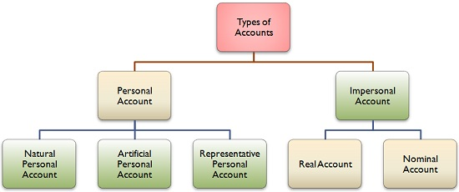
Types of Accounts

Slide 3
Kinds of accounts
There are three kinds of accounts kept by a business firm. They are personal accounts, real accounts and nominal accounts.
Personal accounts:
Natural personal accounts: This type of personal accounts includes all human beings. E.g. Ram’s A/C, Mohan’s A/C, etc.
Artificial personal accounts: Personal accounts which are created artificially by law, such as corporate bodies and institutions, are called artificial personal accounts. E.g. Joint stock companies, clubs, societies, etc.
Representative personal accounts: Accounts which represent a certain person or a group directly or indirectly. E.g. Wages are paid in advance to an employee – a wage prepaid account will be opened in the books of accounts. This wages prepaid account is a representative personal account indirectly linked to the person.

Slide 4
Kinds of accounts
Real accounts:
All assets of a firm, which are tangible or intangible, fall under the category “Real Accounts“.
Tangible real accounts are related to things that can be touched and felt physically. Few examples of tangible real accounts are building, machinery, stock, land, etc.
Intangible real accounts are related to things that can’t be touched and felt physically. Few examples of such real accounts are goodwill, patents, trademarks, etc.

Slide 5
Kinds of accounts
Nominal accounts:
Accounts which are related to expenses, losses, incomes or gains are called Nominal accounts. The dictionary meaning of the word “nominal” is “existing in name only” and the meaning remains absolutely true in accounting sense too, because nominal accounts do not really exist in physical form, but behind every nominal account money is involved. E.g. Salary A/C, Rent A/C, Commission received A/C, etc. The final result of all nominal accounts is either profit or loss which is then transferred to the capital account

Slide 6
Transactions
Journalising
Preparing Balance Sheet
Posting and Balancing
ACCOUNTING CYCLE
Preparing Profit and Loss Account
Preparing trial balances
Preparing trading account

Slide 7
Steps in accounting cycle
i. Identify business events, analyze these transactions and record them in journal
ii. Post journal entries to applicable T-accounts or ledger accounts
iii. Prepare an unadjusted trial balance from the general ledger
iv. Analyze the trial balance and make end of period adjusting entries
v. Post adjusting journal entries and prepare the adjusted trial balance
vi. Use the adjusted trial balance to prepare financial statements
vii. Close all temporary income statement accounts with closing entries
viii. Prepare the post closing trial balance for the next accounting period
Prepare reversing entries to cancel temporary adjusting entries if applicable

Slide 8
Double entry system
Scientific and complete system of recording the financial transactions of an organisation.
There are two aspects involved, namely, Debit the receiving aspect and credit the giving aspect.

Slide 9
Principles of double entry system
(i) In every business transaction, there are two aspects.
(ii) the benefit receiving aspect and benefit giving aspect.
(iii) at least one debit and at least one credit.
(iv) For every debit, there is a corresponding and equivalent credit.

Slide 10
Advantages of Double entry system
Double entry system of accounting offers the following advantages:
Complete record
Ascertainment of Profit or loss
Knowledge of financial position
Accuracy of accounts
No scope for fraud
Tax authorities
Amount due from customers
Amount due to suppliers
Comparative study

Slide 11
Disadvantages of Double Entry System
it results in increase in size of books and it creates the complications.
requires the expert knowledge.
there is a greater chance of errors and mistakes.

Slide 12
Approaches of recording transactions
There are two approaches for recording transactions,
i) Accounting equation approach
ii) Traditional approach.

Slide 13
Types of accounts- Modern Approach
Assets
Liabilities
Capital
Expenses & Losses
Incomes & gains (Revenue

Slide 14
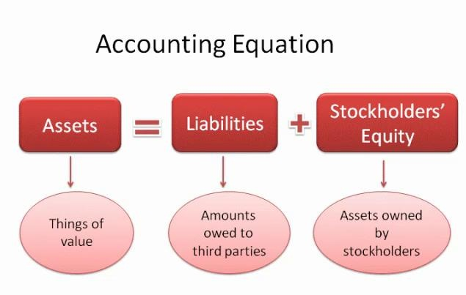
Modern Approach- Rules for Recording under Double Entry System.

Slide 15
Golden rules of accounting – Traditional approach
Accounts | Debit | Credit
Personal Account | the Receiver | the Giver
Real Account | what comes in | what goes out
Nominal Account | all expenses and losses | Credit all incomes and gains

Slide 16
Journal
foundation of the entire book-keeping work
Day to day business transactions
book of original entry or prime entry or preliminary entry or first entry.

Slide 17
Journalising
The process of recording a transaction
in the journal is called journalising.

Slide 18
Rules for Recording under Double Entry System – Modern approach
S.No | Nature | Increase | Decrease
1 | Asset | Debit | Credit
2 | Expenses | Debit | Credit
3 | Liabilities | Credit | Debit
4 | Capital | Credit | Debit
5 | Revenue | Credit | Debit

Slide 19
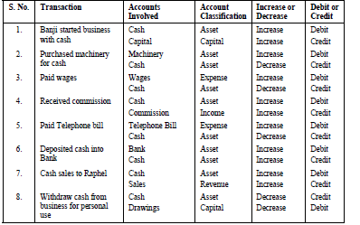
Analysis of Transactions U/ Modern approach

Slide 20
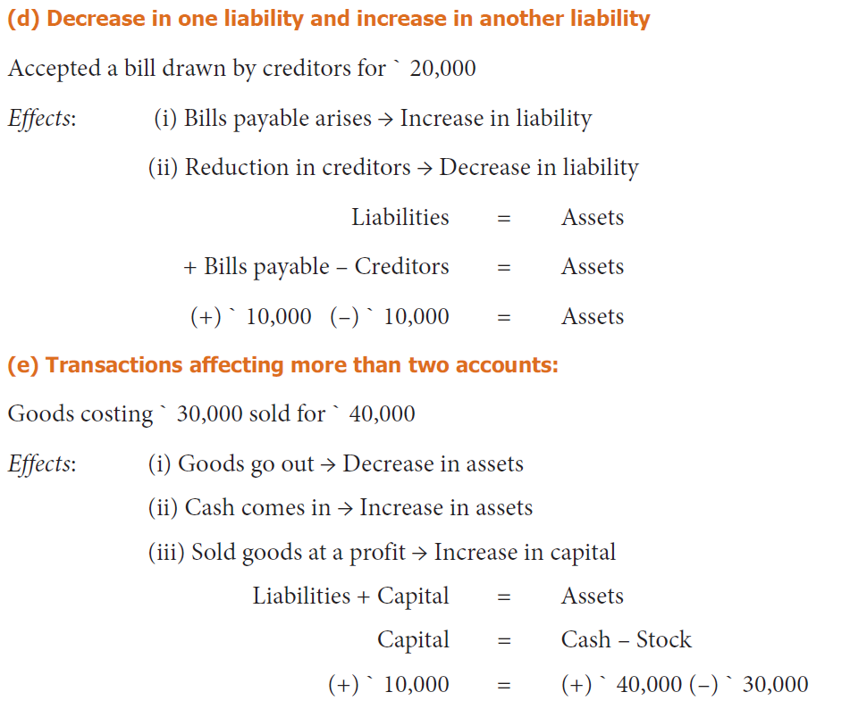

Slide 21
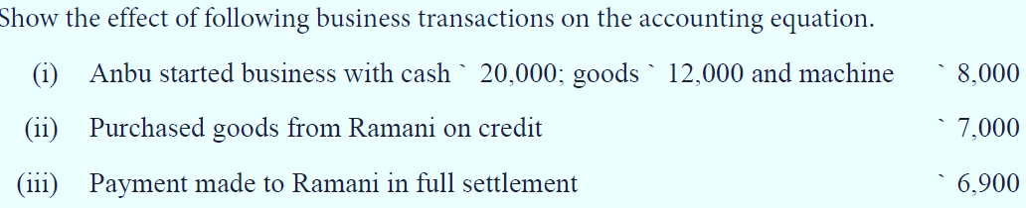
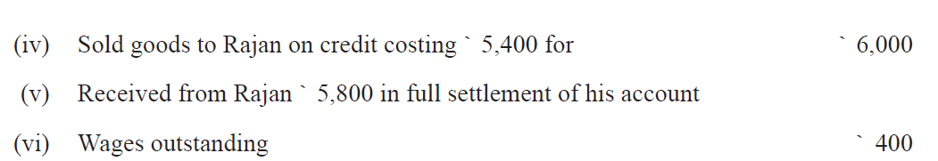
Problem No: 1

Slide 22
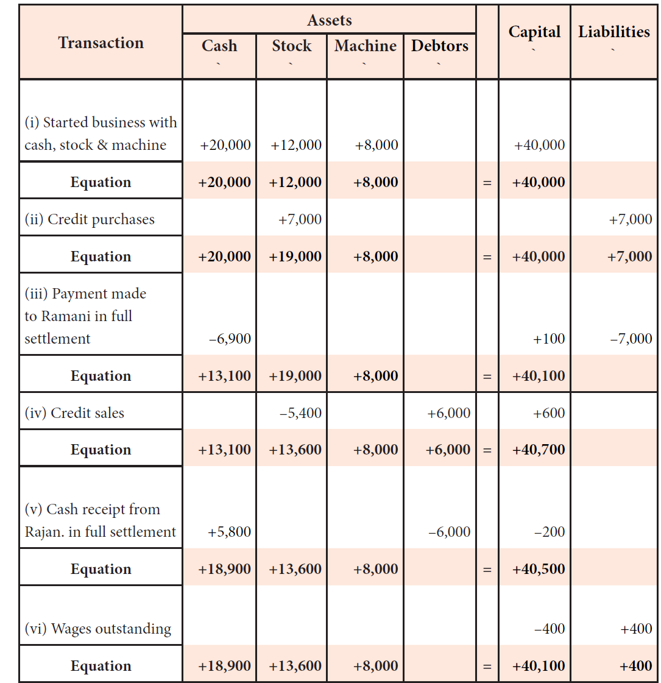
Solution No :1

Slide 23
Problem 2
Show the effect of the following business transactions on assets, liabilities and capital through accounting equations:
Commenced business with cash 20,000
Goods purchased on credit 7,000
Furniture purchased 3,000
paid to creditors 2,000
Amount withdrawn by the proprietor 4,000
Creditors accepted a bill for payment 1,500
interest on capital 1,000
Transfer from capital to loan 5,000
Allotted shares to creditors 1,000

Slide 24
Solution: 2
Transactions | Assets |  |  | = Liabilities + Capital
 | Cash + | Stock+ | Furniture | = Creditors | + B/P | + Loan | + Capital
Commenced business with cash Rs.20000 | 20000 + | 0+ | 0 = | 0 + | 0 + | 0 + | 20,000
Goods purchased on credit Rs. 7,000/- | + | 7,000 + | 0= | 7,000+ | 0+ | 0+ | 0
New Equation | 20,000+ | 7,000+ | 0= | 7,000+ | 0+ | 0+ | 20,000
Furniture Purchased | (-) 3,000 | 0+ | 3,000= | 0+ | 0+ | 0+ | 0
New Equation | 17,000+ | 7,000+ | 3,000= | 7,000+ | 0+ | 0+ | 20,000
Paid to creditors | (-) 2,000+ | 0+ | 0= | (-) 2000+ | 0+ | 0+ | 0
New Equation | 15,000+ | 7,000 | 3,000= | 5,000+ | 0+ | 0+ | 20,000

Slide 25
 | Cash + | Stock+ | Furniture | = Creditors | + B/P | + Loan | + Capital
New Equation | 15,000+ | 7,000 | 3,000= | 5,000+ | 0+ | 0+ | 20,000
Amount withdrawn by proprietor | - 4000+ | 0+ | 0= | 0+ | 0+ | 0+ | -4000
New Equation | 11,000+ | 7,000 | 3,000= | 5,000+ | 0+ | 0+ | 16,000
Creditors accepted a bill | 0+ | 0+ | 0= | -1500+ | 1500+ | 0+ | 0
New Equation | 11000+ | 7000+ | 3000= | 3500+ | 1500+ | 0+ | 16000
Interest on capital | -1000 | 0+ | 0= | 0+ | 0+ | 0+ | -1000
New Equation | 10000+ | 7000+ | 3000= | 3500+ | 1500+ | 0+ | 15000
Transfer from capital to loan | 0+ | 0+ | 0= | 0+ | 0+ | 5000+ | -5000
New Equation | 10000+ | 7000+ | 3000= | 3500+ | 1500+ | 5000+ | 10000
Allotted shares to creditors | 0+ | 0+ | 0= | -1000+ | 0+ | 0+ | 1000
New Equation | 10000+ | 7000+ | 3000= | 2500+ | 1500+ | 5000+ | 11000

Slide 26
From the following transactions, find out the nature of accounts and also state which account should be debited and which should be credited :
Analysis of Transactions
Nature of transaction | A/c’ s involved | Nature of accounts | Debit/ Credit
i) Rent paid | Rent Account | Nominal Account | Debit
 | Cash Account | Real Account | Credit
ii) Interest Received | Cash Account | Real Account | Debit
 | Interest Account | Nominal Account | Credit
iii) Purchased furniture for cash | Furniture Account | Real Account | Debit
 | Cash Account | Real Account | Credit
iv) Machinery sold in cash | Cash Account | Real Account | Debit
 | Machinery Account | Real Account | Credit

Slide 27
v)Purchased goods for cash | Purchase Account A/c | Real Account | Debit
 | Cash Account | Real Account | Credit
vi) Goods sold for cash | Cash account | Real Account | Debit
 | Sales Account | Real Account | Credit
vii) Outstanding Salary | Salary Account | Nominal Account | Debit
 | Outstanding Salary | Personal Account | Credit
viii)Paid to Surinder | Surinder's Account | Personal Account | Debit
 | Cash Account | Real Account | Credit
Ix) Purchased goods from Ram | Purchase A/c | Real Account | Debit
 | Ram A/c | Personal Account | Credit
X)Goods sold to Rahul | Rahul A/c | Personal Account | Debit
 | Sales A/c | Real Account | Credit

Slide 28
Characteristics of Journal
1. Journal is a book of original entry
2. It keeps a chronological record of the transactions i.e., according to occurrence of the transactions.
3. It helps the ledger, which is the principal book of accounts.
4. Journal gives a complete picture of each transaction, which helps in maintaining the identity of the transaction.
5. It tells the true nature of every transaction with the help of narration.
6. It is also known as daybook.

Slide 29
Advantages of Journal
The transactions are recorded in journal as and when they occur so the
chances of error is minimized.
It help in preparation of ledger.
Any transfer from one account to another account is made through Journal.
The entry recorded in journal are self explanatory as it includes narration also.
It can record any such transaction which cannot be entered in any other
books of account.
Every transaction is recorded in chronological order (date wise) so the chances of manipulations are reduced.
Journal shows all information in respect of a transaction at one place.
The closing balances of previous year of accounts related to assets and
liabilities can be brought forward to the next year by passing journal entry in journal.

Slide 30
Limitations of Journal
Limited use: The practical use of the journal is limited. In this, all transactions are not recorded but only those transactions are recorded, which are limited in numbers and which are not written in subsidiary books.
More useful for small business: It is not useful for large businesses, because large organisations have more number of transactions, if all are recorded in one journal then the size of the journal will become big and this will be difficult for one person to maintain.
Lack of business information: In journals, transactions are kept at one place. Therefore, business information can’t be received easily. If traders want information about the cash, bank, stock, creditors, debtors, income and expenses, then with the help of the journal, such information cannot be provided.

Slide 31
Meaning of Goods
Goods mean the things, which are bought by trader for the purpose of resale at a profit. In other words, we can say that goods mean those goods in which a trader deals. For instance, books for a bookseller, furniture for a furniture dealer, etc. Goods account can be classified in the following four parts:
1. Purchases Account: When goods are purchased then purchases account is debited instead of goods account. It records all the purchases of goods.
2. Sales Account: When goods are sold then sales account is credited instead of goods account. It records sales of the goods.
3. Purchases Return Account: If goods purchased are returned, then it is called purchases return. This account is credited.
4. Sales Return Account: If goods sold are returned then it is called sales return. This account is always debited.
5. Closing stock A/c: It is the value of stock remaining unsold. It is the net balance of opening stock+ Purchases(Net) – Sales (Net). It is valued at cost or net realisable value (Market value) whichever is less.

Slide 32
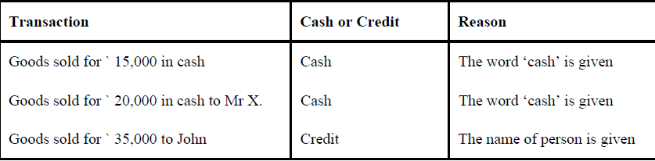
DETERMINATION OF THE NATURE OF TRANSACTIONS WHETHER CREDIT OR CASH
Whether a particular transaction is made for cash or credit in case of purchase and sale of goods, it should be determined.
Cash transaction is to be treated when the word ‘cash’ is mentioned
credit when only the name of the person is given

Slide 33
Special Transactions
Drawings
Assets in the form of Cash or Goods which are withdrawn from a business by the owner(s) for their personal use are termed as drawings.
It is also referred to as withdrawal account. It reduces the total capital invested in the business by the proprietor(s).
In the case of goods withdrawn by owners for personal use, purchases are reduced and ultimately the owner’s capital is adjusted.
In case of goods withdrawn the valuation is done at cost price.

Slide 34
Journal Entry for Drawings of Goods or Cash
In case of cash withdrawn for personal use from in-hand-cash or the official bank account.
Particulars | British approach | American approach
Drawings A/c | Debit | Debit the increase in drawings
To Cash (or) Bank A/c | Credit | Credit the decrease in assets
In case of goods withdrawn for personal use from the business.
Particulars | British approach | American approach
Drawings A/c | Debit | Debit the increase in drawings
To stock (or) PurchaseA/c | Credit | Credit the decrease in assets

Slide 35
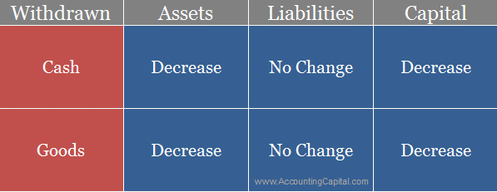
It is a temporary account which is cleared at the end of each accounting year and is not shown as a business expense.
A debit balance in drawing account is closed by transferring it to the capital account. It does not directly affect the profit and loss account in any way.
Drawings A/c | Debit
To Cash (or) Bank A/c | Credit
The accounting equation changes with every transaction that happens in a business. Similarly with withdrawals for personal use the accounting equation changes as follows;
Adjustment entry to show the decrease in capital

Slide 36
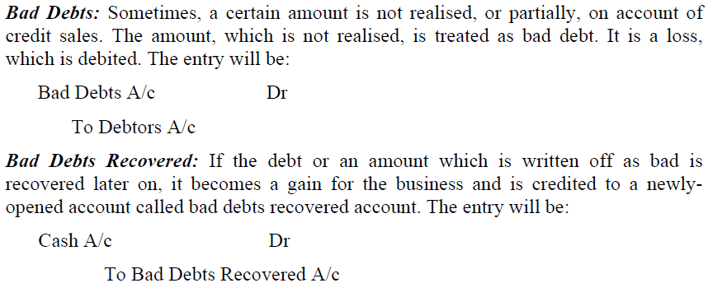
Loss of Goods by Fire/Accident/theft
A business may suffer loss of goods on account of fire, theft or accident. It is a business loss and a nominal account. It also reduces the goods at cost price, and increases the loss/expenses of the business. The entry will be passed as :
Loss by fire/Accident/theft Account Dr.(for loss)
Insurance Company Account Dr. (for insurance claim admitted)
To Purchases Account

Slide 37
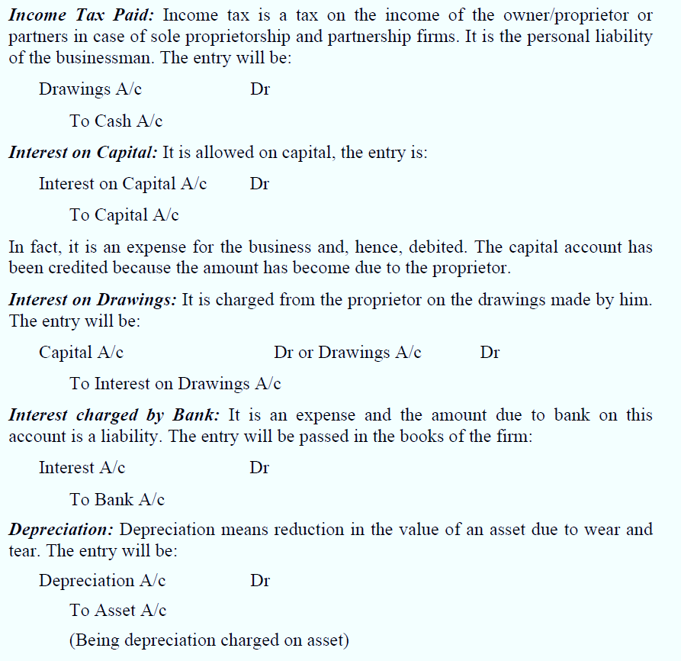

Slide 38
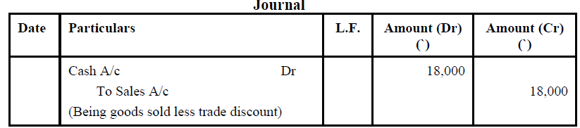
Discount – Trade Discount
It means a deduction, which reduces the received or paid amount from purchases. For example, Mr. A went to a shop for purchasing a fan whose print rate was 1,500 and the shopkeeper takes from him 1,350, then 150 less received by the shopkeeper from Mr. A is called discount. Discount may be of two types:
1. Trade Discount: Trade discount is that discount which is given for promoting sales at a certain percentage on sales, such as discount on clothes, discount on shoes, discount on books, etc. It is not recorded in the books at all; it is deducted from invoice price.
For instance, if a trader sells goods for ` 20,000 at 10% discount then the entry will be:

Slide 39
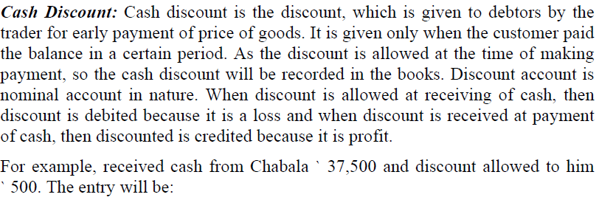
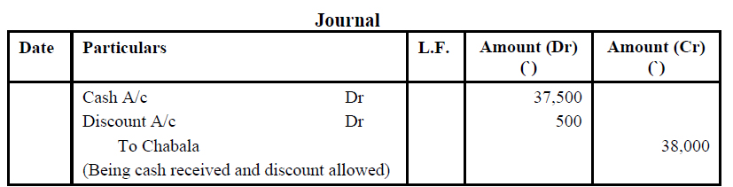
Cash discount

Slide 40
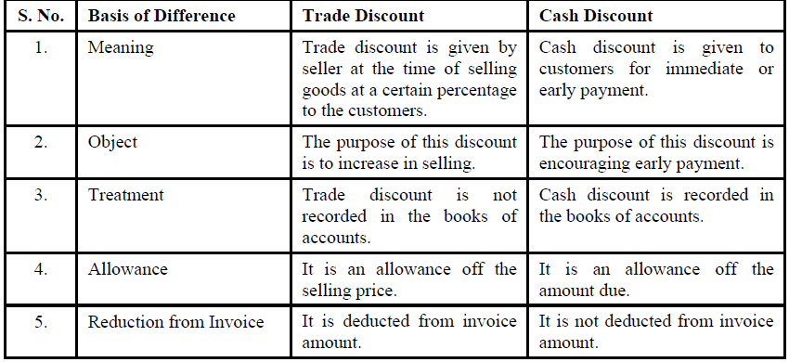
Difference between Trade discount and cash discount

Slide 41
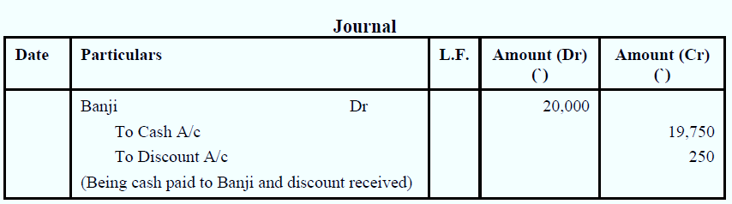

Slide 42
On January 7, 2017, 9,500 received in cash from Hi Tech Pvt ltd. as the full and final settlement of their account worth 10,000. (Allowed a discount of 500)
Date | Particulars | LF. | Debit | Credit | Type of Account | Rule Applied
7 Jan 2014 | Cash A/C Dr |  | 9500 |  | Real A/C | Dr. What comes in
 | Discount Allowed Dr |  | 500 |  | Nominal A/C | Dr. All losses
 | To Unreal Pvt Ltd. |  |  | 10,000 | Personal A/C | Cr. The giver

Slide 43
Format of Journal
Date | Particulars | LF | Debit | Credit

Slide 44
02/01/2015 Mr. Ganapathy started business with cash Rs. 4,00,000. Cash A/c—Real A/c—Comes In—Debited—Dr. ? Capital A/c—Personal A/c—Given—Credited—Cr. ? It means cash has come into the business and Mr. Ganapathy was the provider (or giver) of such.
Date | Particulars | LF | Debit | Credit
02/1/2015 | Cash a/c Dr |  | 400,000
 | To Ganapathy’s Capital a/c |  |  | 4,00,000
 | (Capital invested in their business)
Debit: Increase in assets (Cash)
Credit: Increase in liability (Capital)

Slide 45
Cash payment transactions
Repayment of liabilities in cash 06/01/2015 Repaid Rs.5,000 of bank loans
Debit: decrease in liabilities ( Borrowings) Credit: decrease in assets (Cash)
Date | Particulars | LF | Debit | Credit
06/1/2015 | Bank a/c Dr |  | 5,000
 | To Cash a/c |  |  | 5,000
 | (Bank loan repaid)

Slide 46
Cash payment transactions
Purchase of goods in cash Rs. 1,00,000
Purchase A/c—Real A/c—comes in —Debited—Dr. ?
Cash A/c—Real A/c—Goes out—Credited—Cr. ?.
Debit: Increase in assets(Goods)
Credit: Decrease in assets (Cash)
Date | Particulars | LF | Debit | Credit
02/1/2015 | Purchase a/c Dr |  | 1,00,000
 | To Cash a/c |  |  | 1,00,000
 | (Purchase of goods for cash)

Slide 47
Cash payment transactions
05/01/2015 Bought Furniture for cash Rs.8,000
Debit: Increase in assets ( Furniture)
Credit: Decrease in assets (Cash)
Furniture A/c—Real A/c—Comes In—Debited—Dr. ?
Cash A/c—Real A/c—Goes out—Credited—Cr. ?
Date | Particulars | LF | Debit | Credit
05/1/2015 | Furniture a/c Dr |  | 8,000
 | To Cash a/c |  |  | 8,000
 | (Furniture Purchased for cash)

Slide 48
Cash payment transactions
payment of Expenses in cash 08/01/2015 paid rent and salaries Rs.3,000
Rent & Salaries A/c- Nominal A/c-Expenses- Debited - Dr. ?
Cash A/c—Real A/c—Goes out —Credited— Cr. ?.
Debit: Increase in Expenses ( rent & salaries) Credit: decrease in assets (Cash)
Date | Particulars | LF | Debit | Credit
08/1/2015 | Rent & Salaries a/c Dr |  | 3,000
 | To Cash a/c |  |  | 3,000
 | (rent and salaries paid)

Slide 49
Cash receipt transactions
12/1/2015 Sale of Furniture for cash Rs. 50,000
Cash A/c—Real A/c—Comes in—Debited— Dr. ?
Furniture A/c—Real A/c—Goes out --Credited— Cr. ?.
Debit: Increase in assets(Cash)
Credit: Decrease in asset (Sale of furniture)
Date | Particulars | LF | Debit | Credit
12/1/2015 | Cash a/c Dr |  | 50,000
 | To Furniture a/c |  |  | 50,000
 | (Sale of furniture for cash)

Slide 50
Cash receipt transactions
14/1/2015 Sold goods for Cash Rs.
1,00,000
Cash A/c—Real A/c—Comes in—Debited— Dr. ?
Sales A/c—Nominal A/c—Income—Credited— Cr. ?.
Debit: Increase in assets(Cash)
Credit: Increase in revenue (Sales)
Date | Particulars | LF | Debit | Credit
14/1/2015 | Cash a/c Dr |  | 1,00,000
 | To Sales a/c |  |  | 1,00,000
 | (Sale of goods for cash)

Slide 51
Cash receipt transactions - Borrowings
16/1/2015 Amount borrowed from bank Rs. 2,00,000
Cash A/c—Real A/c—Comes In—Debited—Dr. ?
Bank A/c—Personal A/c—Giver—Credited—Cr. ?(Liability)
There is an increase in liability
Debit: Increase in assets(Cash)
Credit: Increase in liabilities (Borrowings)
Date | Particulars | LF | Debit | Credit
16/1/2015 | Cash a/c Dr |  | 2,00,000
 | To Bank a/c |  |  | 2,00,000
 | (Loan from bank)

Slide 52
Withdraw Cash for household expenses Rs. 2000. This is referred to as Drawings and is debited to Drawings Account.
Drawings A/c—Personal A/c—Receiver—Debited—Dr. ? Cash A/c—Real A/c—Goes Out—Credited—Cr. ?
Date | Particulars | LF | Debit | Credit
16/1/2015 | Drawings a/c Dr |  | 2,000
 | To Cash a/c |  |  | 2,000
 | (Cash withdrawn for personal use)
This results in decrease in Capital, since Drawings is subtracted from Capital to find the Net Capital.

Slide 53
Opening entry
The balances of various assets, liabilities and capital appearing in the balance sheet of previous accounting period are brought forward in the books of the current accounting period, is known as 'Opening Entry'. On Ist April 2006, Singh's assets and liabilities stood as follows : Assets : Cash Rs. 6,000; Bank Rs. 17,000; Stock Rs. 3,000; Bills Receivable Rs.7,000; Debtors Rs. 3,000; Building Rs.70,000; Investments Rs. 30,000; Furniture Rs. 4,000 Liabilities : Bills payable Rs. 5000, Creditors Rs. 9000, Ram's Loan Rs. 13000
Pass an opening Journal entry.
Date | Particulars | LF | Debit | Credit
1. 04. 2006 | Cash a/c Dr |  | 6,000
 | Bank a/c Dr |  | 17,000
 | Stock a/c Dr |  | 3,000
 | Bills receivable Dr |  | 7,000
 | Debtors Dr |  | 3,000
 | Building a/c Dr |  | 70,000
 | Investment a/c Dr |  | 30,000
 | Furniture a/c Dr |  | 4,000
 | To Bills payable a/c |  |  | 5,000
 | To creditors a/c |  |  | 9,000
 | To Ram’s loan a/c |  |  | 13,000
 | To Capital a/c |  |  | 1,13,000
 | (Being the owner commenced business with assets and liabilities)

Slide 54
Compound Entry
When more than two accounts are involved in a transaction and the transaction is recorded by means of a single journal entry instead of passing several journal entries, such single journal entry is termed as 'Compound Journal Entry'.
Date | Particulars | LF | Debit | Credit
8. 12. 2005 | Stock a/c Dr |  | 4,000
 | Furniture a/c Dr |  | 3,000
 | Raman a/c Dr |  | 2,090
 | Salary Dr |  | 7,600
 | Rent Dr |  | 1,400
 | To cash a/c |  |  | 18,090
 | (Being the cash paid)

Slide 55
Problem No. 1
Pass journal entries for the following transactions:
Rohan is declared insolvent. Received from his official receiver 60 Paise in the rupee on a debt of Rs..10,000
Mohan who owed Rs. 2,000 has become insolvent. He pays 50 paise in a rupee in full and final settlement.
Received cash for a bad debt written off last year Rs.5,000

Slide 56
Solution No: 1
Date | Particulars | LF | Debit | Credit
(i) | Cash A/c Dr |  | 6,000
 | Bad debts A/c Dr |  | 4,000
 | To Rohan A/c |  |  | 10,000
 | (Being the cash received from Rohan on his insolvency)
(ii) | Cash A/c Dr |  | 1,000
 | Bad debts A/c Dr |  | 1,000
 | To Mohan A/c |  |  | 2,000
 | (Being the cash received from Mohan on his insolvency)
(iii) | Cash A/c Dr |  | 5,000
 | To Bad debts Recovered A/c |  |  | 5,000
 | (Bad debts recovered)

Slide 57
Problem No: 2
Journalise the following transactions :
2005
Nov. 1 Paid to Arun Rs. 5,250 discount allowed by him Rs.50
6 Received from Somesh Rs.1,900 and from KomeshRs.400
8 Goods purchased for cash Rs. 4,000
Furniture purchased for cash Rs. 3,000
Paid cash to Ram Rs. 2,090
Paid Salary in cash Rs. 7,600
Paid Rent in cash Rs. 1,400

Slide 58
Solution No :2

Slide 59
Problem No: 3
Journalise the following transactions in the books of Rahav:
Bought goods from Sona Rs. 20,000 less trade discount 20% plus GST @ 10%.
Sold goods costing Rs. 6,000 to Rama for Rs. 8,000 plus GST @ 10%
Sold the balance goods for Rs. 16,000 and charged GST @ 10% to Mohan against payment by cheque which was banked on the same day.
Deposited the GST into government account by cheque.

Slide 60
Solution: 3
Date | Particulars | L.F. | Amount (Dr.) Rs. | Amount Cr. Rs.
1 | Purchases A/c Dr. GST Paid A/c Dr. To Sona (Goods purchased from Sona ) |  | 16,000 1,600 | 17,600
2 | Rama Dr. To Sales A/c To GST Collected A/c (Goods sold & charged GST @10%) |  | 8,800 | 8,000 800
3 | Bank A/c Dr. To Sales A/c To GST Collected A/c (Goods sold to Mohan against cheque & charged GST @10%) |  | 17,600 | 16,000 1,600
4 | GST Collected A/c Dr. To GST paid A/c (Adjustment of GST paid withGST collected) |  | 1,600 | 1,600
5 | GST Collected A/c Dr. To Bank A/c (Balance amount of GST deposited in Govt.A/c |  | 800 | 800

Slide 61
Problem No: 4
Pass journal entries for the following transactions:
6.1.2015 Mohan started the business with cash Rs 40,000
6.1.2015 Purchased goods from Ram Rs. 30,000
8.1.2015 Goods sold for cash Rs. 6,000
15.1.2015 Furniture purchased for cash Rs. 8,000
18.1.2015 Salary paid to manager Rs. 6,500
20.1.2015 Rent paid to landlord Rs.1,000

Slide 62
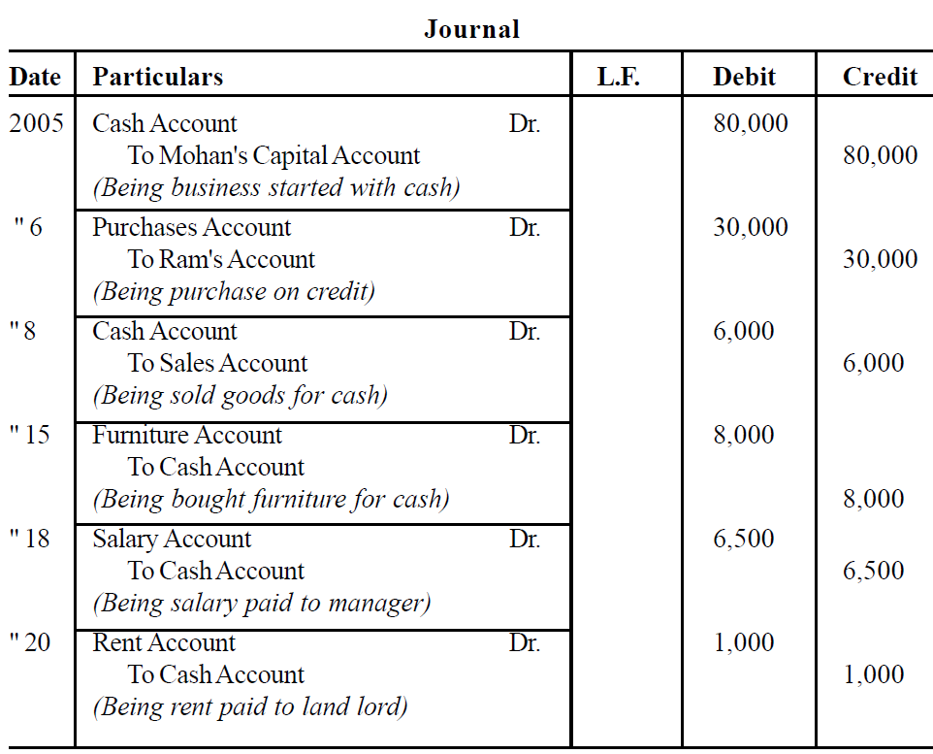
Solution No :4

Slide 63
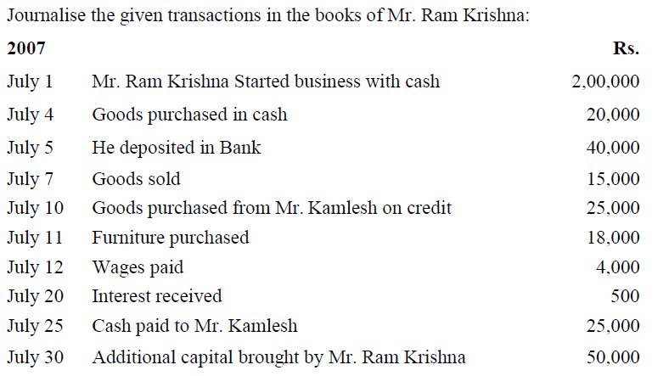
Problem No: 5

Slide 64
Solution No :5
Journal entries in the books of Ram Krishna
Date | Particulars | LF | Debit | Credit
July 1 | Cash A/c Dr |  | 2,00,000
 | To Capital A/c |  |  | 200,000
 | (Being start of business by Mr.Ram krishna)
July 4 | Purchase A/c Dr |  | 20,000
 | To Cash A/c |  |  | 20,000
 | (Purchase of goods in cash)
July 5 | Bank A/c Dr |  | 40,000
 | To Cash A/c |  |  | 40,000
 | (Cash paid in to bank)

Slide 65
Date | Particulars | LF | Debit | Credit
July 7 | Cash A/c Dr |  | 15,000
 | To Sales A/c |  |  | 15,000
 | (Being sale of goods in cash)
July 10 | Purchase A/c Dr |  | 25,000
 | To Mr.Kamalesh A/c |  |  | 25,000
 | (Purchase of goods on credit)
July 11 | Furniture A/c Dr |  | 18,000
 | To Cash A/c |  |  | 18,000
 | (Cash purchase of furniture)

Slide 66
Date | Particulars | LF | Debit | Credit
July 12 | Wage A/c Dr |  | 8,000
 | To Cash A/c |  |  | 8,000
 | (Being payment of wages in cash)
July 20 | Cash A/c Dr |  | 500
 | To Interest A/c |  |  | 500
 | (Being receipt of interest)
July 25 | Mr.Kamalesh A/c Dr |  | 25,000
 | To Cash A/c |  |  | 25,000
 | (Being payment of credit purchases)
July 30 | Cash a/c Dr To capital a/c (additional capital introduced) |  | 50,000 | 50,000

Slide 67
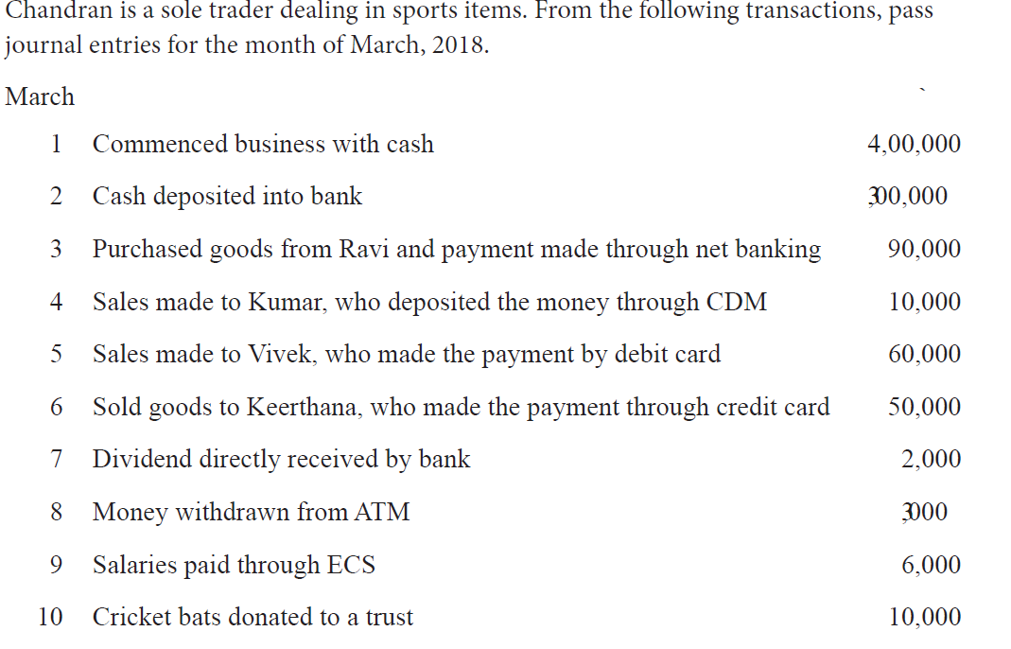
Problem No: 6

Slide 68
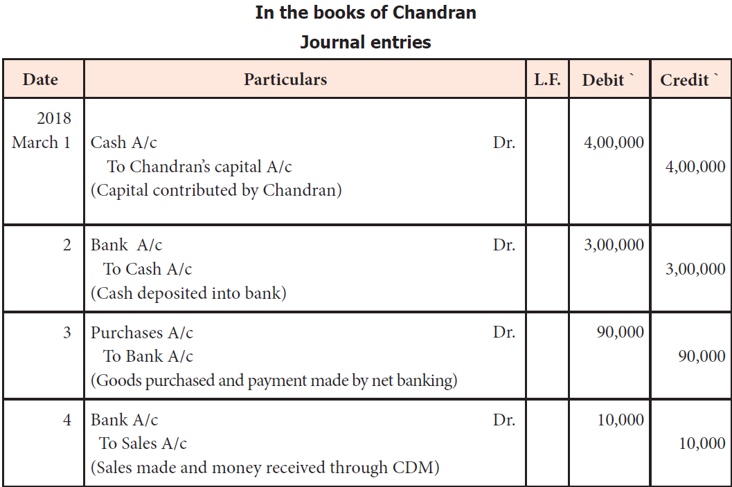
Solution No :6

Slide 69
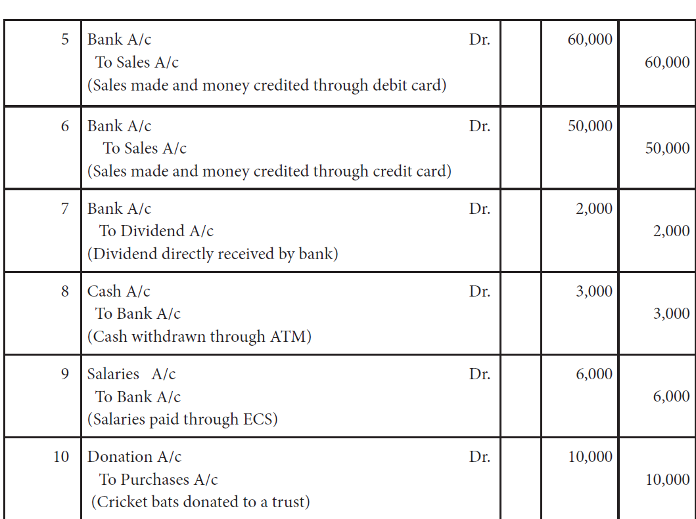
Solution No :6 (CONT….)

Slide 70
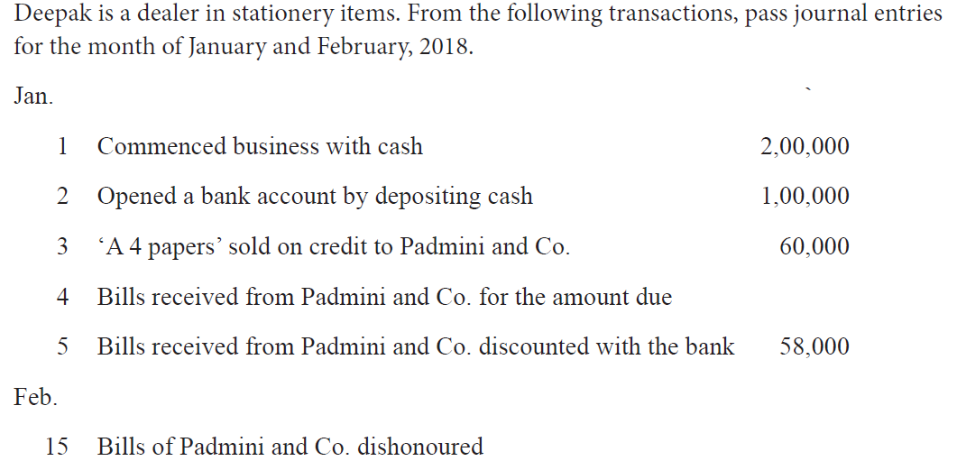
Problem No: 7

Slide 71
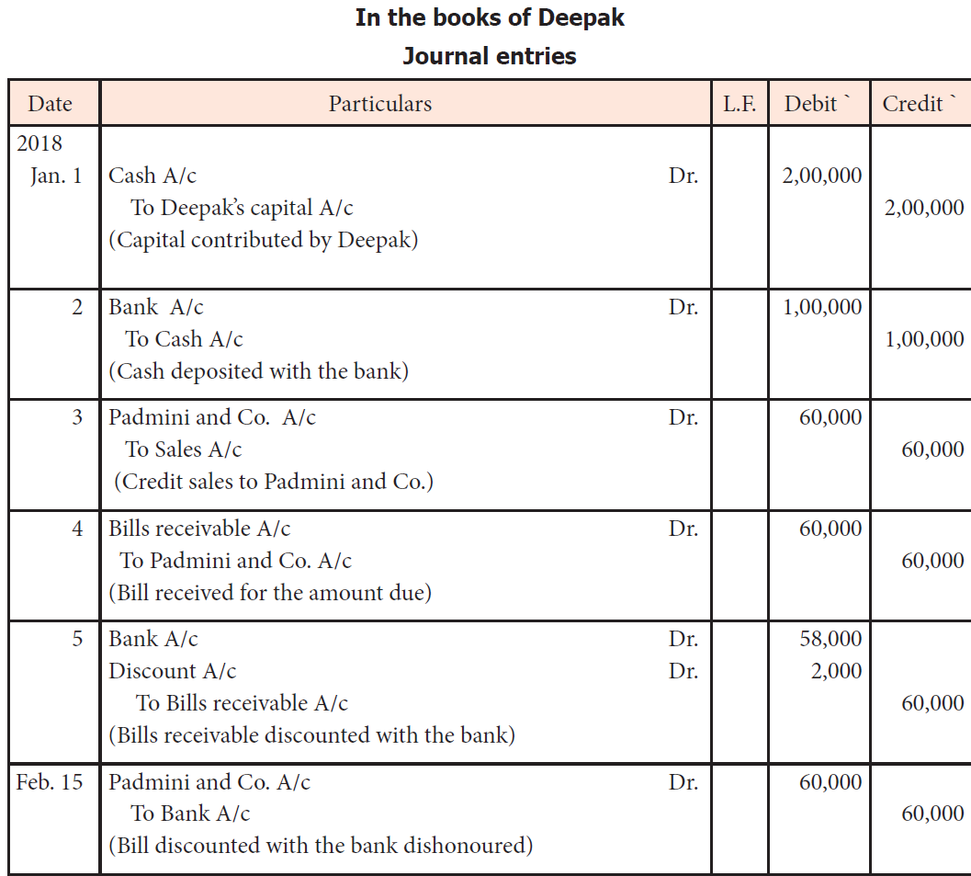
Solution No : 7

Slide 72
Problem No : 8
Pass journal entries for the following transactions:
(i) Purchased goods from Sanjiv at a list price of Rs. 40,000 at 10% Trade discount and 5% Cash discount. Amount was paid at the time of purchase itself.
(ii) Purchased goods from Vijay of Rs.40,000 on 10% Trade discount and 5% cash discount. Half of the amount was paid at the time of purchase.
(iii) Sold goods to Anil for Rs. 20,000 allowed him 10%Trade discount and 10% Cash discount. Received half of the amount by cash and balance half by cheque within specified time.
(iv) Sold goods to Ajay for Rs.50,000 allowing 5% cash discount and 10% Trade discount. Half of the amount was received by cheque within specified time.

Slide 73
Solution No: 8
JOURNAL
Date | Particulars | LF | Debit | Credit
(i) | Purchase A/c Dr |  | 36,000
 | To Cash A/c |  |  | 34,200
 | To Discount received A/c |  |  | 1,800
 | (Being the goods purchased from sanjiv)
(ii) | Purchase A/c Dr |  | 36,000
 | To vijay a/c |  |  | 18,000
 | To cash a/c |  |  | 17,100
 | To Discount received A/c |  |  | 900
 | (Being the goods purchased from vijay)

Slide 74
Solution No: 8 (CONT….)
(iii) | Cash A/c Dr |  | 8,100
 | Bank A/c Dr |  | 8,100
 | Discount allowed A/c Dr |  | 1,800
 | To Sales A/c |  |  | 18,000
 | (Being the goods sold to Anil)
(iv) | Ajay A/c Dr |  | 22,500
 | Bank A/c Dr |  | 21,375
 | Discount allowed A/c Dr |  | 1,125
 | To Sales A/c |  |  | 45,000
 | (Being the goods sold to Anil)

Slide 75
Solution No: 8 (CONT…)
Working notes: Calculation of Trade discount and cash discount
(i) Invoice price of goods | 40,000 | (ii) Invoice price of goods | 40,000
Less: Trade discount@10% | 4,000 | Less: Trade discount@10% | 4,000
 | 36,000 |  | 36,000
Less: Cash discount@5% | 1,800 | Cash transactin 36,000x1/2= | 18,000
Amount paid | 34,200 | Less: cash discount | 900
 |  | Net amount paid | 17,100
(iii) Gross value of sales | 20,000 | (iii) Gross value of sales | 50,000
Less: TD @10% | 2,000 | Less: TD @10% | 5,000
 | 18,000 | Net value of sales | 45,000
Less: CD @10% | 1,800 | A. Cash transacction45,000x1/2 | 22,500
Amount paid | 16,200 | Less: Cash discount@5% | 1,125
Cash 16,200x1/2 | 8,100 | Net amount received | 21,375
Cheque 16,200x1/2 | 8,100
 |  | B. Credit transaction (45,000x1/2) | 22,500

Slide 76
Problem No : 9
Journalise the following transactions in the books of Manoj:
2017 April 1 April 10 April 15 April 18 April 20 | Advanced Rs1,00,000 by cheque to Jaspal for purchase of building for total consideration of Rs 20,00,000 Paid the balance amount by cheque. Issued cheque for stamp papers Rs1,40,000; for registration of building; paid lawyer’s fee Rs15,000; and brokerage Rs20,000in cash. Rs25,000 were paid in cash to paint the building before is occupation. Purchased office furniture of Rs1,00,000 and in exchange old furniture (book value Rs20,000) valued at Rs12,000 was given. Balance amount was paid by issue of cheque. An order was placed with M/S. PIONEER INDUSTRIES for a lathe machine costing Rs5,00,000. A cheque for Rs50,000 was issued as advance.

Slide 77
Solution :9
Date | Particulars | L.F | Dr.(Rs.) | Cr.(Rs.)
2017, April 1 | Advance for Building A/C ...Dr. To Bank A/c (Being the advance paid for purchase of Building) |  | 1,00,000 | 1,00,000
April 10 | BuildingA/c ....Dr. To Bank A/c To Advance for Building A/c (Being the balance consideration paid and advance adjusted) |  | 20,00,000 | 19,00,000 1,00,000
 | BuildingA/c ...Dr. To Bank A/c (Being the cost of stamp papers to register the building paid) |  | 1,40,000 | 1,40,000
 | BuildingA/c ...Dr. To Cash A/c (Being the cash paid to lawyer Rs.15,000 and Broker Rs.20,000) |  | 35,000 | 35,000
April 15 | BuildingA/c ....Dr. To Cash A/c (Being the experience incurred to paint the building) |  | 25,000 | 25,000

Slide 78
Solution :9
April 18 | Furniture A/c (New) ...Dr. Profit and Loss A/c (Loss On Furniture) ...Dr. To Furniture A/c To Bank A/c (Being the new furniture purchased in exchange of old furniture) |  | 1,00,000 8,000 | 20,000 88,000
April 20 | Advancefor Machinery A/c ....Dr. To Bank a/c (Being the advance paid against order of machine) |  | 50,000 | 50,000

Slide 79
Problem No : 10
Journalise the following transactions:
Purchased goods on credit from Anbu Rs. 5,000
Goods returned by Babu Rs. 500
Sale of typewriter for Rs. 1,000
Withdrew for domestic use Rs. 250
Paid Radha Rs. 1,980 in full settlement of a debt of Rs. 2,000
(d) Cheque for Rs. 2,500 received from Charles in settlement of a debt of Rs. 2,750, returned dishonoured.

Slide 80
Solution:10
Dates | Particulars | L.F. | Debit | Credit
(a) | Purchase A/c Dr |  | 5,000
 | To Anbu A/c |  |  | 5,000
 | [Being goods purchased on credit]
(b) | Sales Returns A/c Dr |  | 500
 | To Babu A/c |  |  | 500
 | [Being goods returned by Babu]
(c) | Cash A/c Dr |  | 1,000
 | To Typewriter A/c |  |  | 1,000
 | [Being sale of typewriter]
(d) | Drawings A/c Dr |  | 250
 | To Cash A/c |  |  | 250
 | [Being amount drawn for domestic use]

Slide 81
Solution:10
(e) | Radha A/c Dr |  | 2,000
 | To Cash A/c |  |  | 1,980
 | To Discount received A/c |  |  | 20
 | [Being Radha paid off & discount received]
(f) | Charles A/c Dr |  | 2,750
 | To Bank A/c |  |  | 2,500
 | To Discount allowed A/c |  |  | 250
 | [Being Cheque received from Charles in settlement of a debt of Rs. 2,750 dishonoured and discount allowed thereon cancelled]

Slide 82
Problem No:11
Journalise the following transactions:
Murugan who owes Rs. 3,000 pays Rs. 2,850 in full settlement.
Goods worth Rs. 400 given as charity.
Received a first and final dividend of 75 paise in the rupee from the official receiver of Mr. Raju who owed us Rs. 3500.
Sold to Shanthi goods worth Rs. 40,000 less 2% discount and received Rs. 39,200 net by cheque.

Slide 83
Solution:11
Date | Particulars | L.F. | Debit | Credit
(a) | Cash A/c Dr |  | 2,850
 | Discount allowed A/c Dr |  | 150
 | To Murugan A/c |  |  | 3,000
 | [Being amount received and discount allowed in full settlement]
(b) | Charity A/c Dr |  | 400
 | To Purchase A/c |  |  | 400
 | [Being goods given as charity]
(c) | Cash A/c (3,500 * 75%) Dr |  | 2,625
 | Bad debts A/c Dr |  | 875
 | To Raju A/c |  |  | 3,000
 | [Being cash received and balance treated as bad debt due to insolvency of customer]
(d) | Cash A/c Dr |  | 39,200
 | To Sales A/c |  |  | 39,200
 | [Being goods sold and cheque received after allowing 2% Trade discount]

